Slide 1


Slide 2



CODE VERSE HACKATHON 2025
Problem Statement
WasteTrace - End-to-End Waste Tracking with Accountability and Incentives
Team Name
We Bare Bugs
Team Members
1) Shalvi Maheshwari
2) Laukika Shinde
3) Sarvesh Sapkal

Slide 3
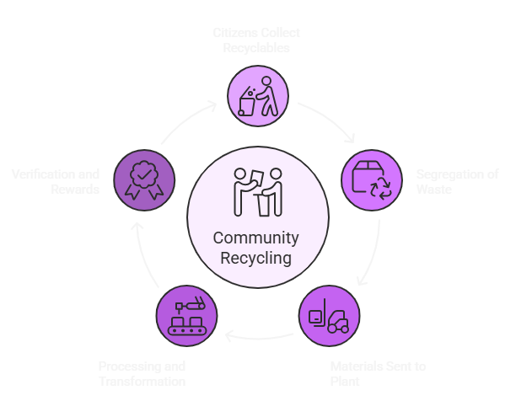
WasteTrace - End-to-End Waste Tracking with Accountability and Incentives
Proposed Solution :
WasteTrace is a software-only platform that makes the journey of every waste item trackable, verifiable, and transparent.
It works like a “delivery tracker for waste”:
citizen → collector → segregation → recycling plant → verified & rewarded.
Each step is logged with photo evidence, GPS, and timestamps, secured using cryptographic hashing (and later blockchain).
Citizens earn eco-points for proper disposal, redeemable for vouchers/rewards (gamified adoption).

Slide 4
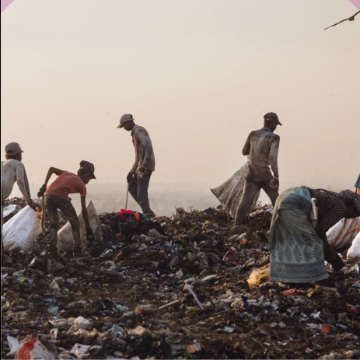
WasteTrace - End-to-End Waste Tracking with Accountability and Incentives
The Problem
How our solution addresses the Problem
Solves the trust gap: citizens never know if segregated waste actually gets recycled → we provide verifiable proof.
Helps municipalities track efficiency & reduce leakage to landfills.
Enables corporates to meet EPR (Extended Producer Responsibility) compliance with auditable evidence.

Slide 5
WasteTrace
Uniqueness and Innovation
We studied 20+ international and National research papers, articles and a local citizen survey.
Link to our literature review: https://docs.google.com/spreadsheets/d/10CikgIK6JeTxtHaEkcDMQqDuL2c2K7jkLhTnZG2hNas/edit?usp=sharing
Upon deep research, we found the following research gaps and we came up with new and innovative solutions to deal with them:
Research Gap Identified | Insights from Literature | Our Solution / How We Overcome It
Lack of end-to-end transparency | Most studies stop at municipal dashboards; citizens can’t see the waste journey. | Citizen-facing blockchain ledger → everyone can trace where their waste goes.
Poor segregation at source | AI models exist for waste classification, but adoption is low in real settings. | AI photo-based classification + simple collector upload → boosts accuracy & adoption.
Weak citizen participation | Surveys show low motivation; people don’t see personal benefit in waste segregation. | Gamified rewards & leaderboards → citizens earn vouchers/points for compliance.
Limited trust in reporting | Data often manipulated by intermediaries; accountability missing. | Immutable blockchain records → ensures tamper-proof accountability.
Scaling & real-world deployment challenges | Pilots exist, but very few full-scale working systems. | Modular software-first approach → no hardware dependency, scalable across cities.

Slide 6
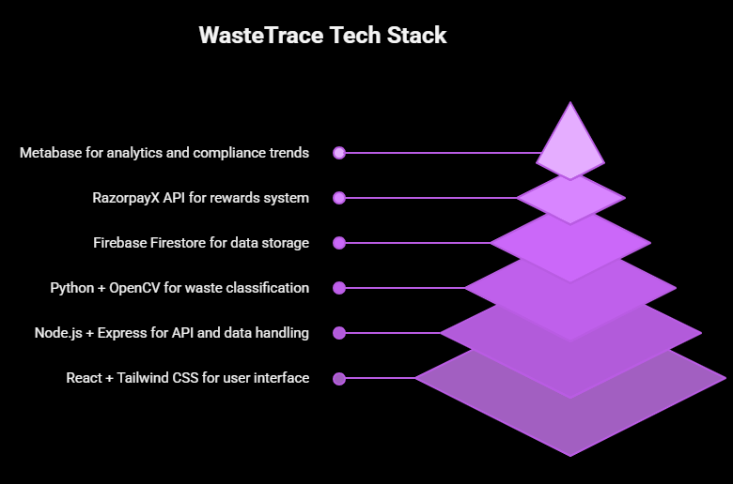
Technical Approach
Technologies to be Used
Frontend: React / Flutter (cross-platform citizen + collector apps).
Backend: Node.js / Django REST API.
Database: PostgreSQL + hash-chain ledger (simulate blockchain).
AI/ML: TensorFlow / PyTorch model for waste classification (plastic, organic, e-waste).
Cloud & APIs: AWS/GCP for hosting; Google Maps API for geotagging; Mock voucher API (later RazorpayX/Gyftr integration).

Slide 7
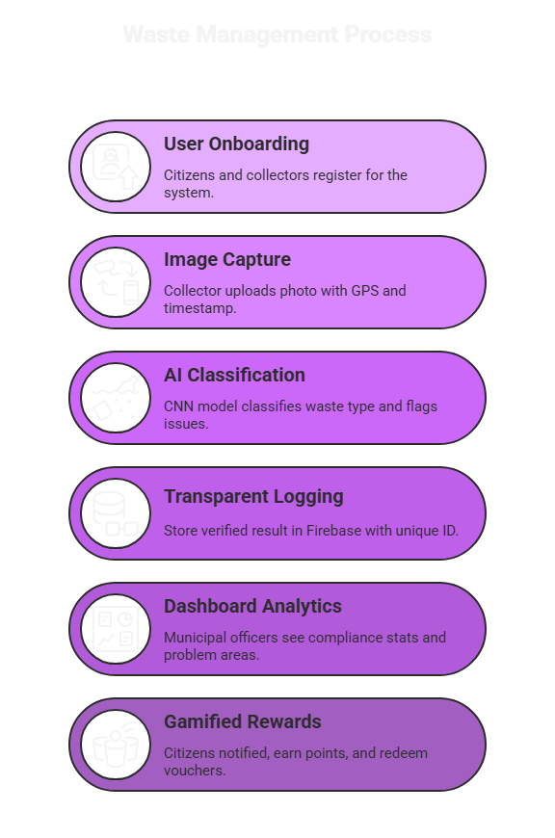
Technical Approach
Methodology & Process for Implementation
Citizen App → Upload photo → AI detects category → Waste Ticket generated.
Immutable Logging → Metadata stored with hash → prevents tampering.
Collector & Operator Apps → Scan ticket → upload photo & GPS → update waste journey.
Verification Engine → Hash comparison ensures authenticity of photos/events.
Gamification Layer → Eco-points for citizens → Mock voucher redemption for demo.
Dashboards → Municipal heatmaps + corporate sustainability reports.
Waste Management Process

Slide 8
Feasibility and Viability
Feasibility Analysis
Software-first → no heavy IoT/hardware needed, making it cost-effective.
Works on existing smartphones → no dependency on expensive infrastructure.
Pilot-friendly → can start with a college campus / single ward before scaling city-wide.
Potential Challenges & Risks
Collector compliance (extra effort).
Fraud attempts (fake photos, old uploads).
Connectivity issues in field.
Scaling incentives (funding vouchers). .
3) Strategies for Overcoming Challenges
UX design: one-tap uploads, batch capture, offline-first sync.
Fraud prevention: EXIF timestamp + GPS validation + duplicate photo detection.
Collector motivation: tie verified logs to payments & bonuses.
Long-term funding: municipal CSR budgets + corporate EPR funds → cover voucher costs.

Slide 9
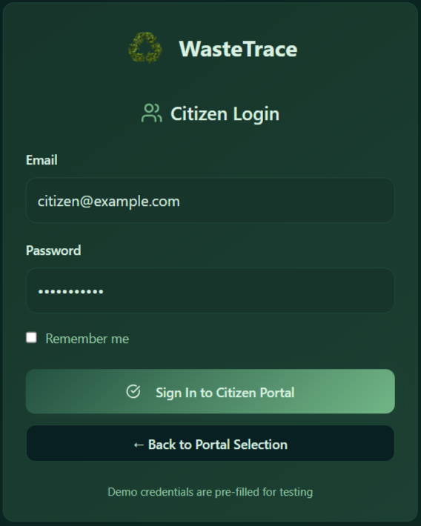
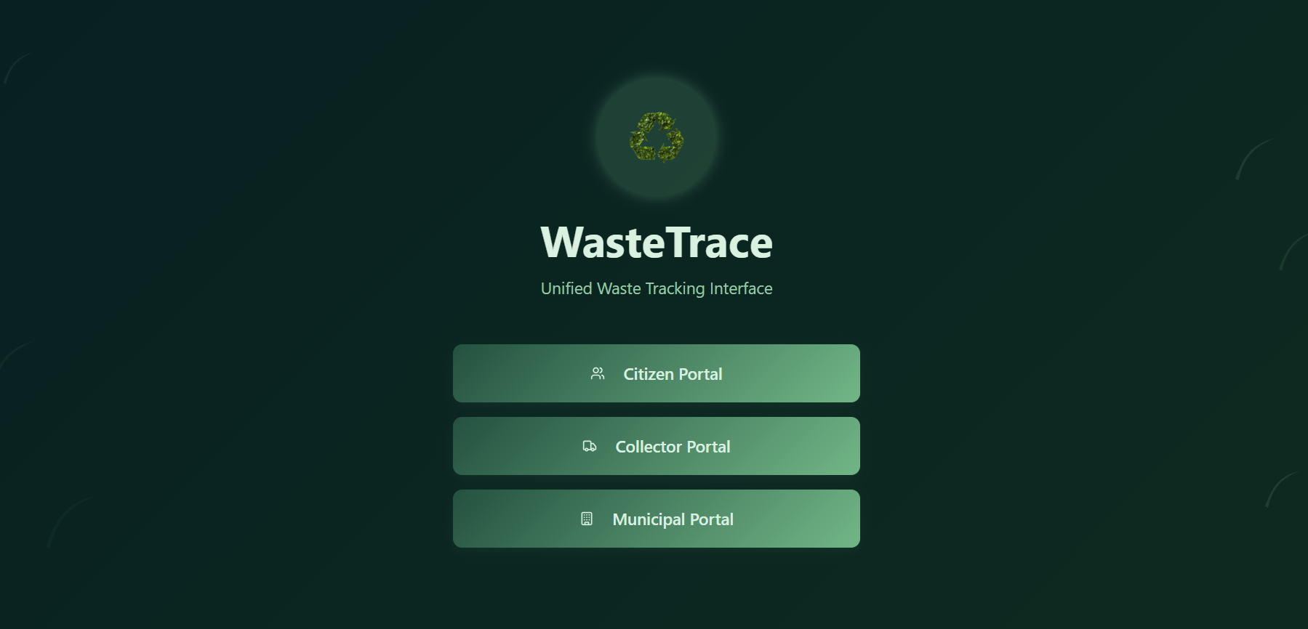
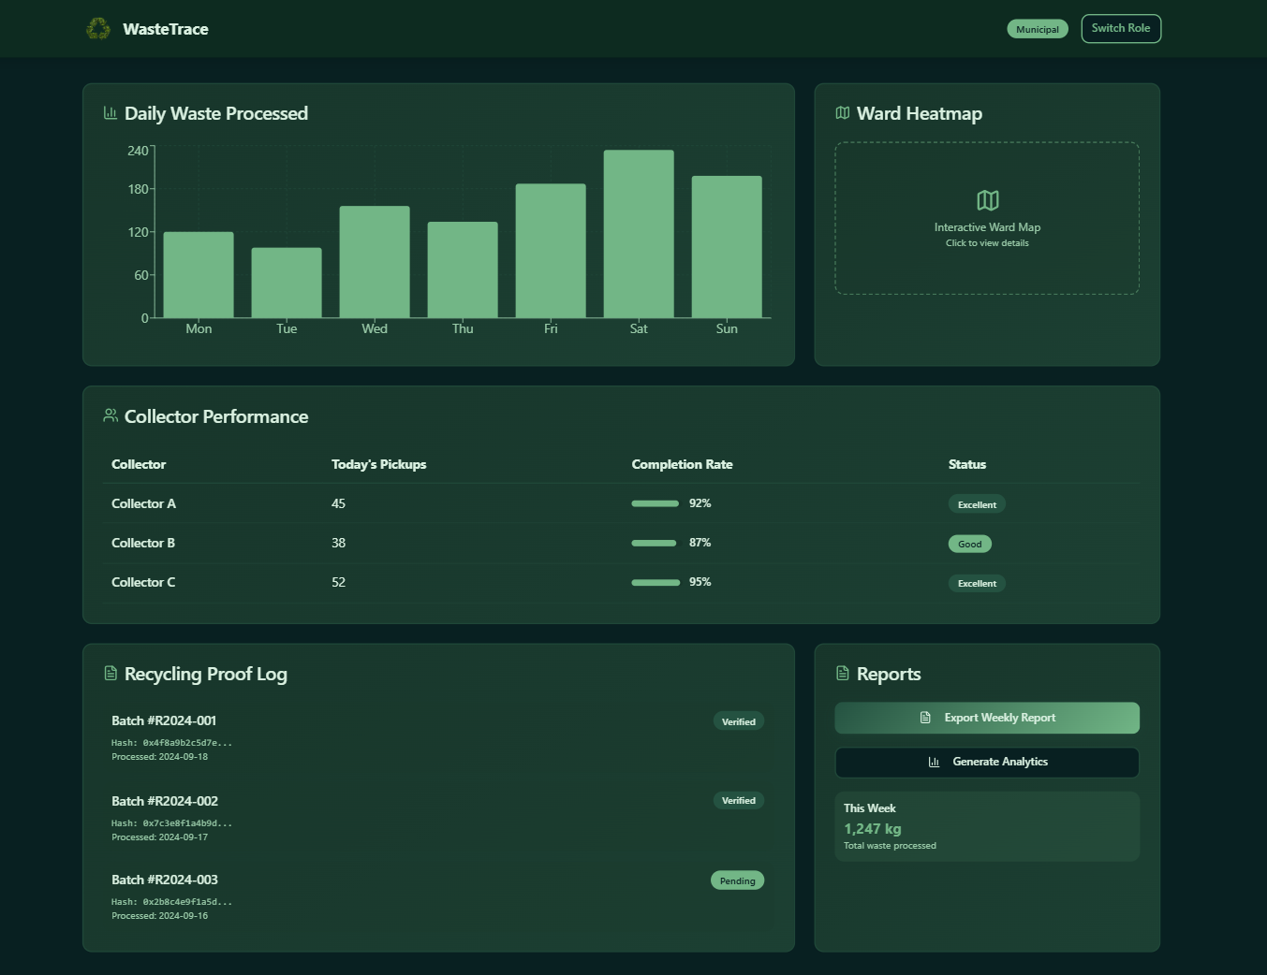
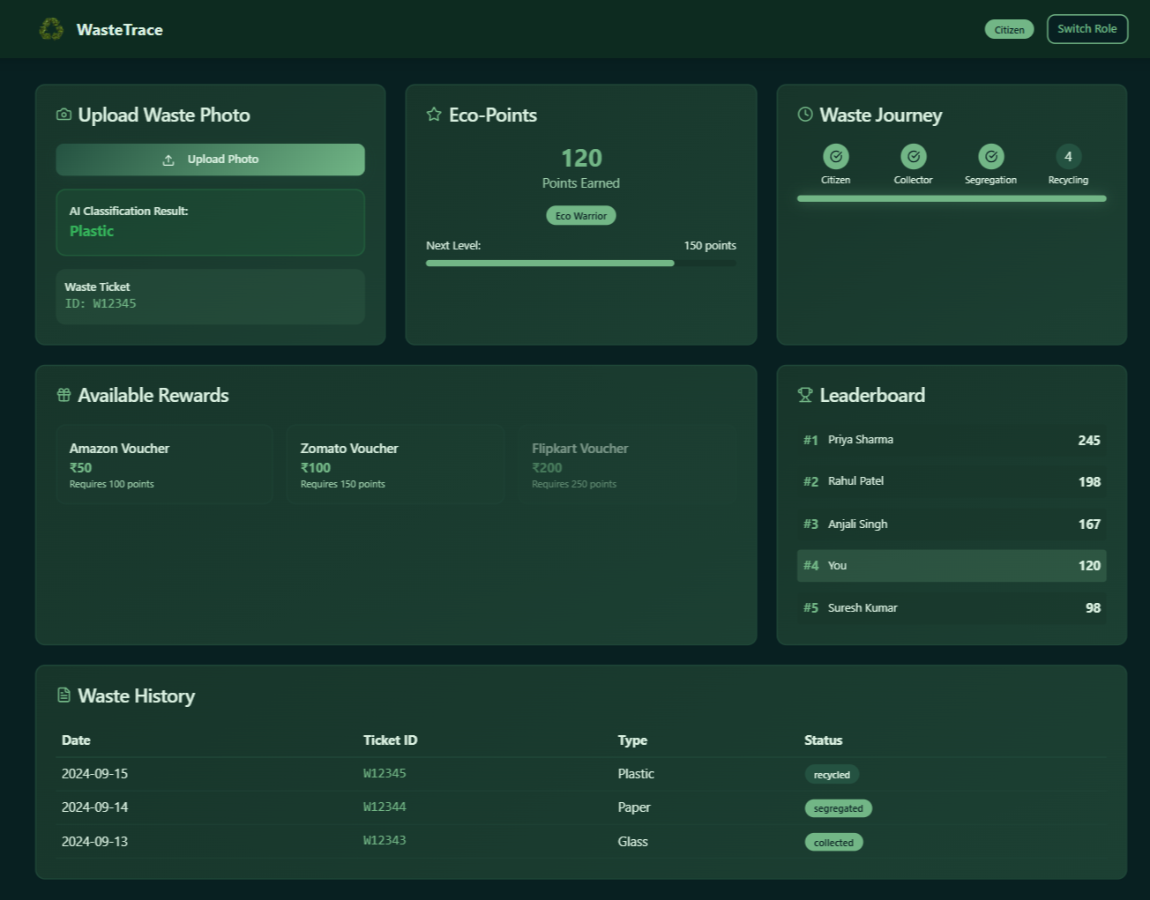
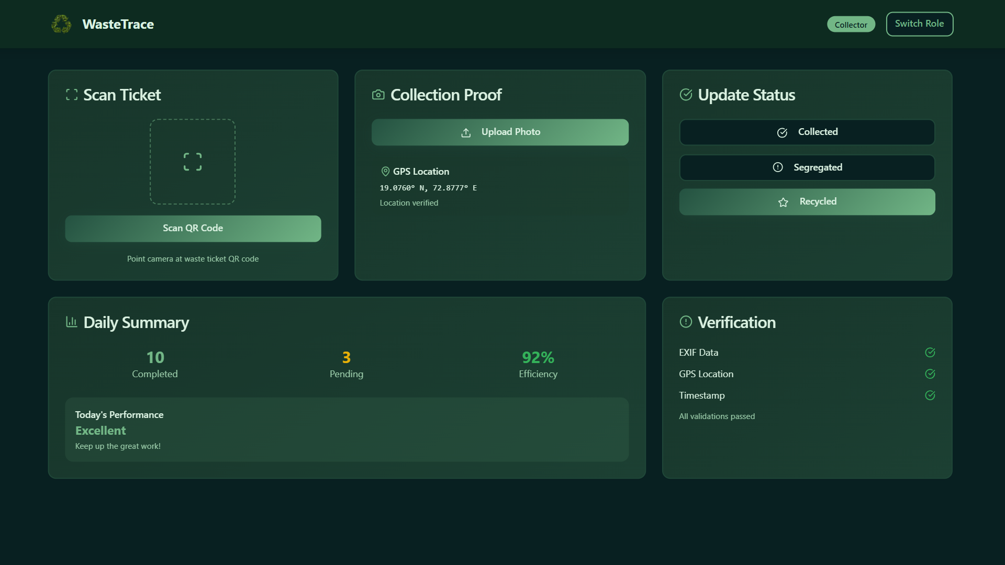
dashboard screenshots
note: this is just an illustration of the landing page, to show the features of the project. actua project will vary.

Slide 10
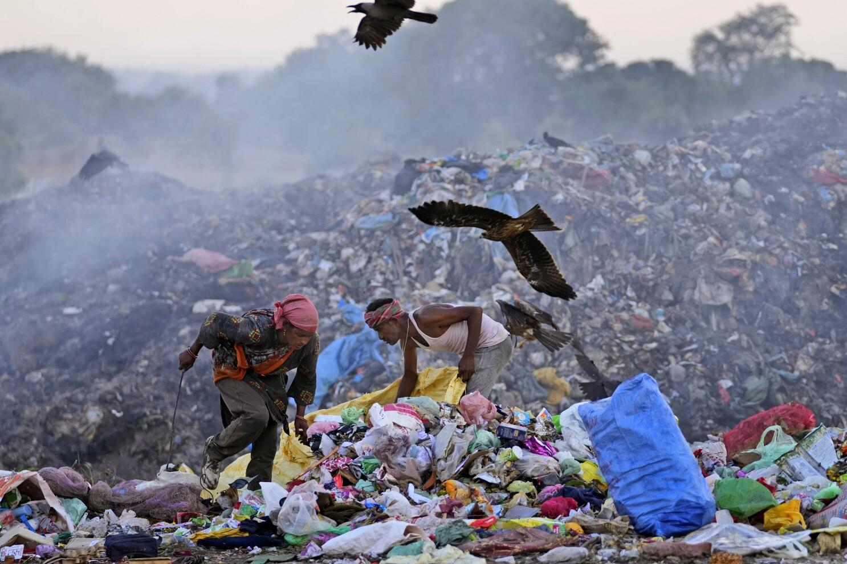
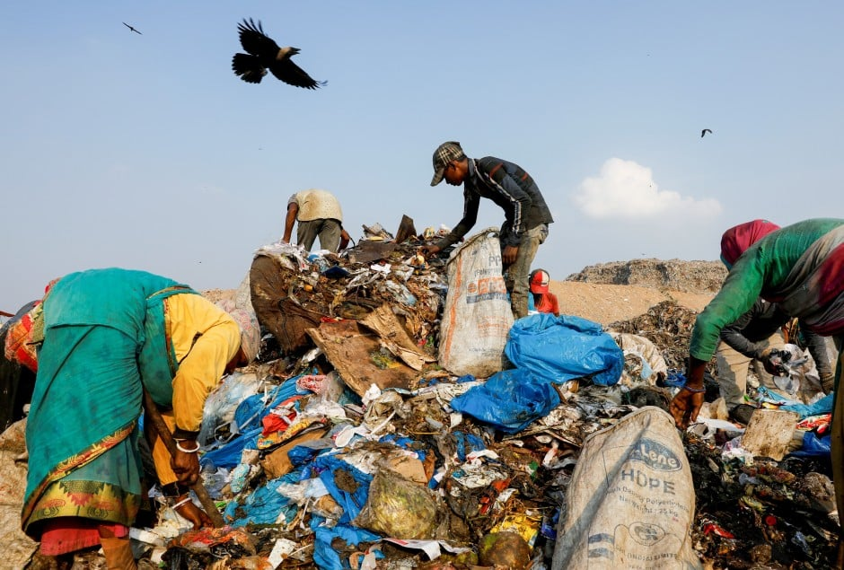
Impact and Benefits
Potential Impact
Environmental: Higher recycling rates, reduced landfill waste, progress toward UN SDGs.
Social: Restores citizen trust in waste systems → visible accountability.
Governance: Helps municipalities enforce segregation, optimize routes, and meet Swachh Bharat/Smart City goals.
Corporate: Provides auditable reports for EPR, strengthening ESG compliance and brand reputation.
Over 50% of generated municipal waste remains mixed and unsegregated — citizens rarely know its final fate.
Unverified collection and transfer operations lead to waste being dumped rather than processed, reducing citizen trust.

Slide 11
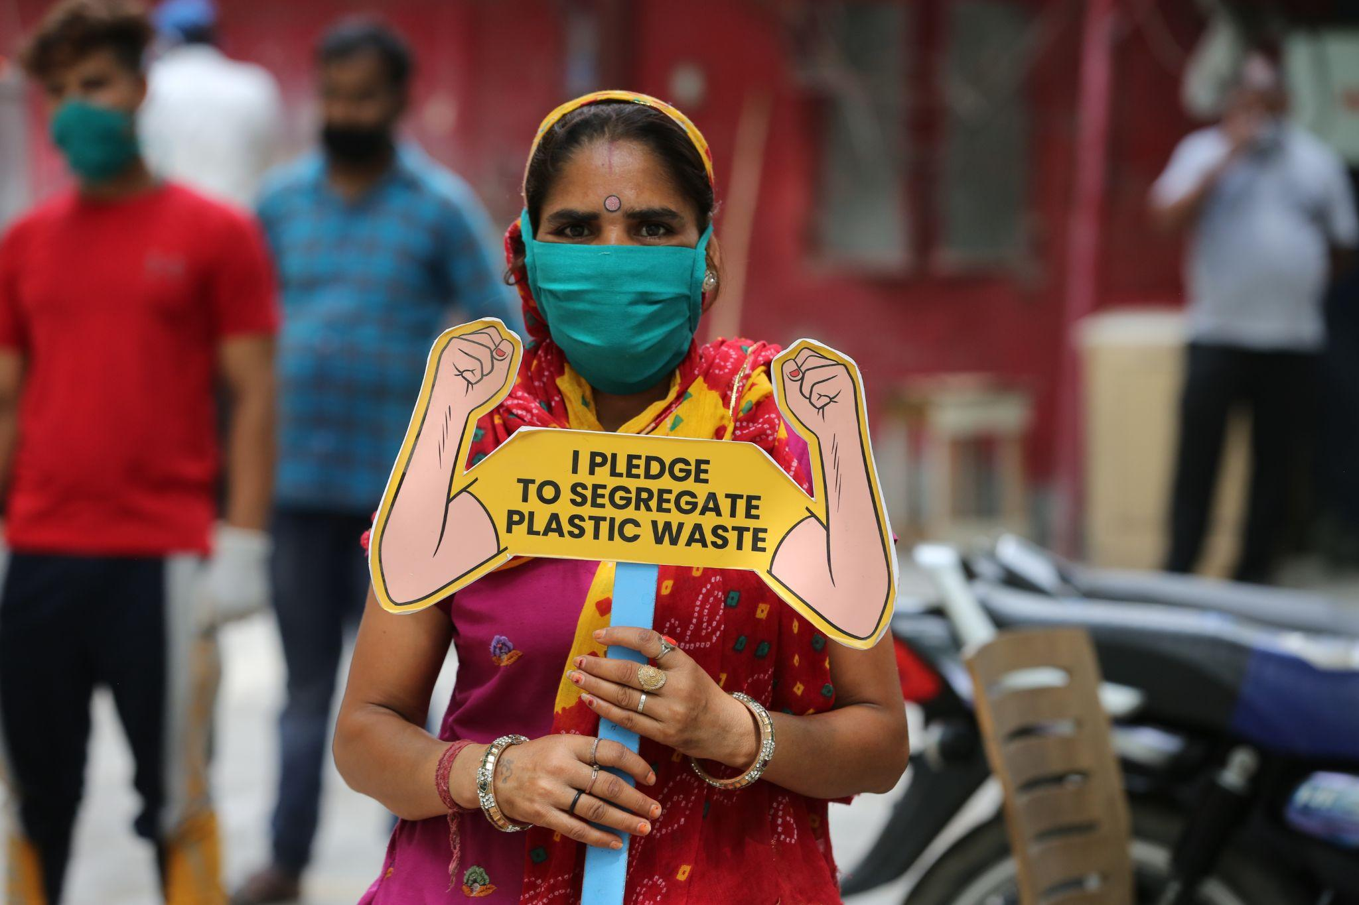
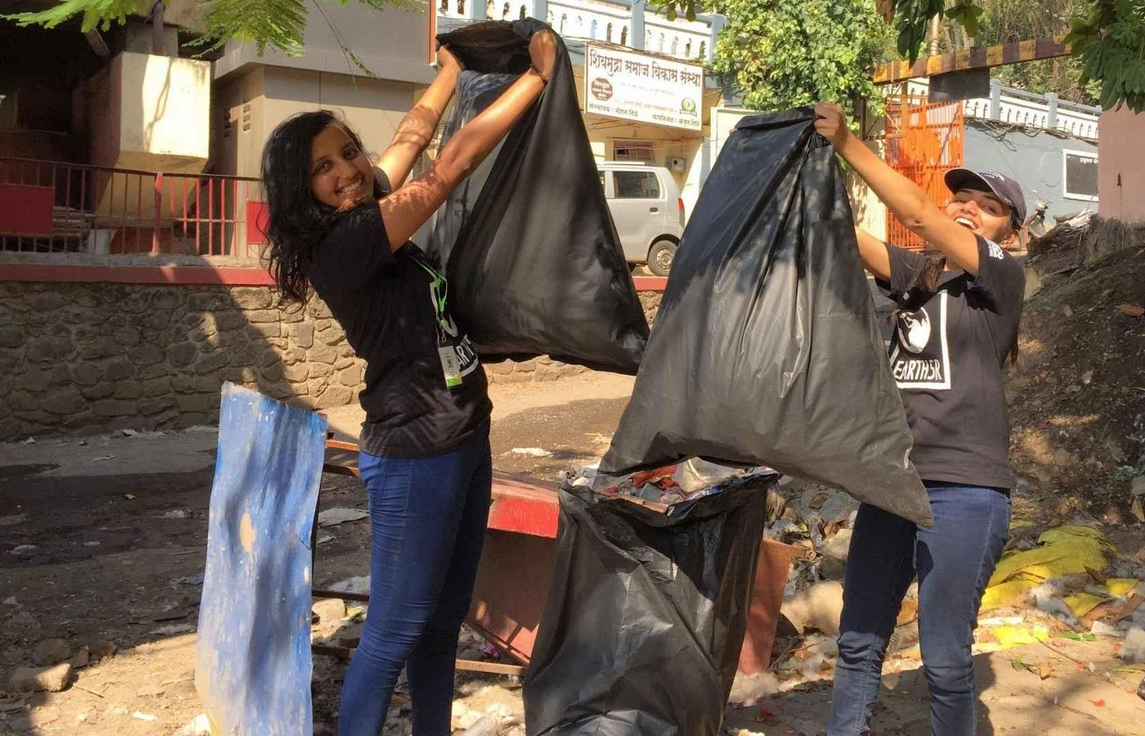
Impact and Benefits
Empowering waste workers — over 1.5 million informal pickers in India contribute without recognition or proof of work.
Community participation boosts collection reliability by ~60% when citizens see their efforts directly validated.
Benefits of the Solution
Citizens: Transparency + rewards → encourages sustained participation.
Municipalities: Real-time dashboards → smarter policy & efficient waste handling.
Corporates: Low-cost, verifiable compliance tool → measurable ESG impact.
Society: Cleaner cities, healthier communities, reduced plastic pollution.

Slide 12
Thank You

